Slide 1
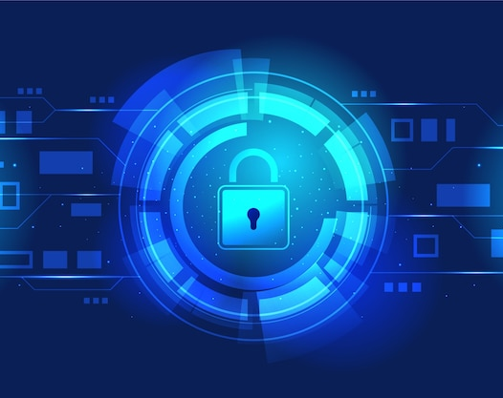


Security 10203280 D/618/740
By: Marwan Al Farah Tutor: Eng. Sami Al Mashaqbeh

Slide 2



Misconfiguration
Unauthorized access
Compliance issues
Blocked legitimate traffic
Increased risk of cyber attacks
Notes:
Incorrect configuration of network security devices, such as firewall policies and third-party VPNs, can have significant impacts on IT security
Firewall policies are used to regulate incoming and outgoing network traffic based on predetermined security rules. If these rules are not configured correctly, it can lead to security vulnerabilities such as unauthorized access to the network, an increased risk of cyber-attacks, some compliance issues, as well as the possibility of mistakenly blocking necessary traffic, such as safe websites and application.

Slide 3
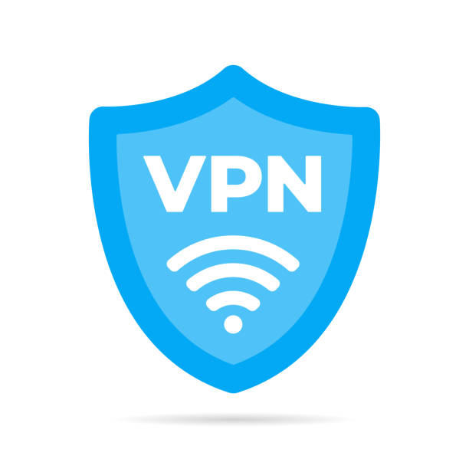
Misconfiguration
Compromised Confidentiality and Integrity
Compliance issues
Compromised Integrity
Insecure Connection
Notes:
Similarly, VPNs (Virtual Private Networks) are used to securely connect to a remote network, to encrypt this internet connections, in order to protect sensitive data from being intercepted by unauthorized parties. If a VPN is not configured correctly, it can compromise the confidentiality and integrity of the connection and the data that is being transmitted, due to the connection being insecure thus potentially exposing sensitive data to malicious activity. Third-party VPN misconfiguration could also lead to some compliance issues.

Slide 4
Misconfiguration
Misconfigurations in general can lead a variety of security breaches and they introduce many vulnerabilities to the system. They also lead to a decrease in the company’s productivity, as well as additional costs in the form of legal fees, damage control, and loss of customer trust.
Notes:
Continuing on, incorrect configuration of network security devices can also result in decreased productivity and increased costs for an organization. As mentioned before, if a firewall policy is not configured correctly, it may block necessary network traffic and prevent employees from accessing the resources they need to do their jobs efficiently. In addition, if a security breach does occur as a result of incorrect configuration, the organization may face additional costs in the form of legal fees, damage control, and loss of customer trust.
Overall, it is important for organizations to ensure that their network security devices are configured correctly in order to maintain the security and efficiency of their IT systems. It may be helpful for organizations to regularly review and test the configurations of their security devices to ensure that they are properly set up and functioning as intended.

Slide 5
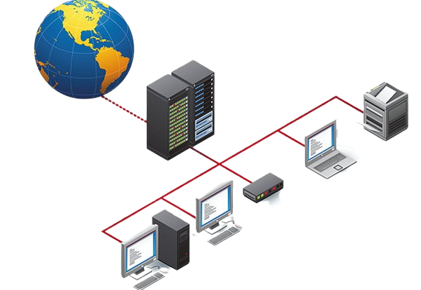
Network Security Techniques
DMZ (Demilitarized Zone):
Segmenting the network to isolate its internal network from the Internet.
Allowing external users to access certain resources on the internal network, such as web servers or email servers, while protecting the internal network from external threats.
Allowing incoming traffic to be screened and filtered before it is allowed to enter the internal network.
Helping prevent unauthorized access to sensitive data and systems and improve network security.
Notes:
There are several techniques that can be implemented to improve network security, such as DMZ (Demilitarized Zone), static IP, and NAT (Network Address Translation). Below is a detailed recommendation and explanation for each technique based on the scenario:
DMZ (Demilitarized Zone):
A DMZ is a network segment that sits between the internal network and the Internet. It allows external users to access certain resources on the internal network, such as web servers or email servers, while protecting the internal network from external threats. The DMZ acts as a buffer between the internal network and the Internet, allowing incoming traffic to be screened and filtered before it is allowed to enter the internal network. This can help prevent unauthorized access to sensitive data and systems and improve network security.
Recommendation: I recommend that Warmaksan implement a DMZ to isolate its internal network from the Internet. By setting up a DMZ, Warmaksan can allow external users to access certain resources on the internal network, such as web servers or email servers, while protecting the internal network from external threats. This can help prevent unauthorized access to sensitive data and systems and improve network security.

Slide 6
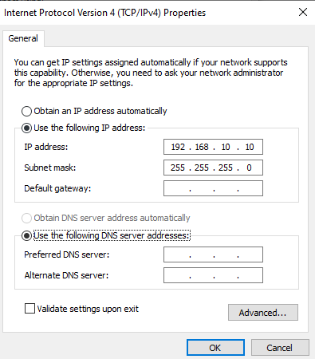
Network Security Techniques
Static IP (Internet Protocol):
Providing better control over network resources.
It makes it easier to identify, monitor and track access to these systems and resources.
Helping prevent unauthorized access to sensitive data and systems and improve network security.
Notes:
Static IP:
A static IP is a fixed, unchanging IP address that is assigned to a device or system. By assigning static IPs to devices on the network, Warmaksan can better control and monitor access to its network resources. For example, Warmaksan could assign static IPs to servers or other critical systems, making it easier to identify and track access to these systems. This can help prevent unauthorized access and improve network security.
Recommendation: I recommend that Warmaksan assign static IPs to servers and other critical systems on its network. By using static IPs, Warmaksan can better control and monitor access to these systems, making it easier to identify and track access. This can help prevent unauthorized access and improve network security.

Slide 7
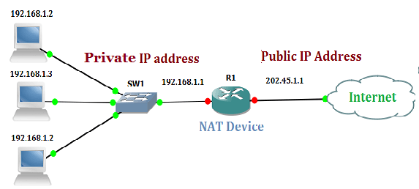
Network Security Techniques
NAT (Network Address Translation):
Allowing multiple devices on a private network to share a single public IP address.
Hiding the IP addresses of its internal devices from external users.
NAT makes it more difficult for attackers to target individuals.
Allowing the company to control access to its internal network, as only traffic from authorized devices will be allowed to pass through.
Notes:
NAT (Network Address Translation):
NAT is a technique that allows multiple devices on a private network to share a single public IP address. By using NAT, Warmaksan can hide the IP addresses of its internal devices from external users and make it more difficult for attackers to target them. NAT can also help improve network security by allowing Warmaksan to control access to its internal network, as only traffic from authorized devices will be allowed to pass through.
Recommendation: I recommend that Warmaksan use NAT to hide the IP addresses of its internal devices and control access to the internal network. By using NAT, Warmaksan can make it more difficult for attackers to target its internal devices, as their IP addresses will be hidden. NAT can also help improve network security by allowing Warmaksan to control access to its internal network, as only traffic from authorized devices will be allowed to pass through.
Overall, implementing these techniques can help to improve network security by adding additional layers of protection and making it more difficult for attackers to gain access to sensitive data. It is important for organizations to carefully consider their network security needs and determine which techniques are most appropriate for their specific scenarios.

Slide 8

Network Monitoring System
It is a tool that continuously monitors a network for issues and alerts administrators when something goes wrong. There are several benefits to using a network monitoring system, including:
Improved network uptime
Early detection of problems
Increased security
Improved efficiency
Identify and resolve network issues
Gather detailed information about network performance
Notes:
Network Monitoring System:
A network monitoring system is a tool that continuously monitors a network for issues and alerts administrators when something goes wrong. Network monitoring systems are used to monitor and analyze network performance, availability, and security. These systems provide valuable insights into network performance and can help identify potential issues before they cause major disruptions.
There are several benefits to using a network monitoring system, including:
Improved network uptime: By continuously monitoring the network, a network monitoring system can quickly detect and alert administrators to issues that could disrupt network uptime. This can help ensure that the network is always available to users, improving productivity and customer satisfaction.
Early detection of problems: A network monitoring system can alert administrators to problems before they become critical, allowing them to be addressed before they cause significant disruptions. This can help prevent outages and reduce the amount of time that users spend troubleshooting issues.
Increased security: A network monitoring system can help identify potential security threats, such as unauthorized access attempts or malware infections. This can help administrators take proactive measures to secure the network and protect sensitive data.
Improved efficiency: By automating the process of monitoring the network, a network monitoring system can help administrators save time and resources. This can allow them to focus on more important tasks, such as maintaining and improving the network.
Identify and resolve network issues: By constantly monitoring network performance, these systems can detect and alert administrators to potential problems, allowing them to take action before an outage occurs. This can help to minimize downtime and ensure that the network is running smoothly and efficiently.
Gather detailed information about network performance: These systems can provide detailed metrics on network traffic, bandwidth usage, and other key performance indicators. This information can be used to fine-tune network settings, optimize performance, and identify potential bottlenecks.

Slide 9
Network Monitoring System
Examples of Network Monitoring Systems and Tools:
SNMP (Simple Network Management Protocol)
ICMP (Internet Control Message Protocol)
NetFlow
SIEM (Security Information and Event Management)
SOAR (Security Orchestration, Automation and Response)
Notes:
SNMP (Simple Network Management Protocol) is a widely used protocol for network management and monitoring. It is used to monitor and manage network devices, such as routers, switches, servers, and other network-attached devices. SNMP provides a standardized way for network devices to communicate with management systems and allows administrators to monitor and control network devices in real-time.
Other protocols that can be used for network monitoring include ICMP (Internet Control Message Protocol), which is used to test the reachability of network devices and measure round-trip times; and NetFlow, which is used to collect and analyze network traffic data. SOAR (Security Orchestration, Automation and Response): This is a technology used to automate incident response and security workflows. It helps security teams to improve their incident management and response capabilities. SIEM (Security Information and Event Management): This is a security management system that collects, correlates, and analyzes security-related data from various sources, such as network devices, servers, and applications. SIEMs are used to identify security threats, compliance violations, and suspicious activity. These protocols, along with SNMP, provide a comprehensive approach to network monitoring and management.
Overall, the use of a network monitoring system can provide a wide range of benefits, including the ability to proactively identify and resolve network issues, gather detailed information about network performance, and improve network availability and security. It is important to choose a monitoring system that supports the protocols and features needed for the specific network environment.

Slide 10
Physical and Virtual Security Measures
Physical Security Measures:
Security cameras
Access controls
Physical barriers
Environmental controls
Virtual Security Measures:
Firewalls
Encryption
Two-factor authentication
Security software
Notes:
Physical and Virtual Security Measures:
There are a range of physical and virtual security measures that can be employed to ensure the integrity of IT security. Some examples of physical measures include:
Security cameras: Security cameras can be used to monitor physical access to a facility or data center, helping to prevent unauthorized access or vandalism.
Access controls: Access controls, such as keycards or biometric scanners, can be used to limit physical access to a facility or data center to authorized personnel only.
Physical barriers: Physical barriers, such as fences or walls, can help prevent unauthorized access to a facility or data center.
Environmental controls: Environmental controls, such as temperature and humidity monitoring, can help protect against physical damage to equipment.
Some examples of virtual measures include:
Firewalls: Firewalls can be used to block unauthorized access to a network and protect against cyber threats.
Encryption: Encrypting data can help protect against unauthorized access or interception of sensitive information.
Two-factor authentication: Two-factor authentication can help prevent unauthorized access to accounts by requiring an additional form of authentication, such as a code sent to a mobile phone.
Security software: Security software, such as antivirus or malware protection, can help protect against cyber threats.
Backups: A procedure for making extra copies of data for the purpose of restoration in case of loss or damage. Backup the data whether it was full incremental or differential backup.
Implementing a combination of physical and virtual security measures can help ensure the integrity of IT security and protect against physical and cyber threats.

Slide 11

Thank You

